Slide 1
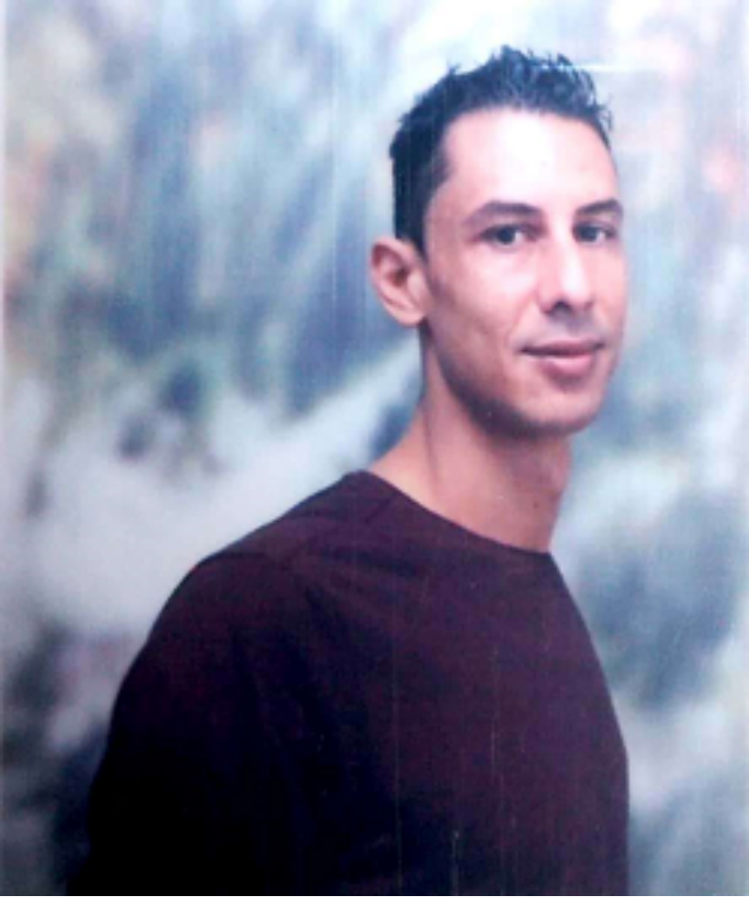




















Thiago Genuíno Gonçalves Martins
Professional Summary

Slide 2












Summary – Thiago Genuíno Gonçalves Martins
Trajectory Summary
AESCA-MG
BAR PADRE
EUSTAQUIO
Attendant
Lecturer
Multifunctional
Operator
Quality inspector
Stockist
Office Assistant
Analyst
Inventory
Supervisor
Team Leader
Receptionist
Finance Sector
Project Sector
2004 – 2007
2007 – 2008
2008 – 2017
2017 – 2017
2017 – 2018
2018 – 2021
2021 – Current
Time course
2004
2015 – 2017
2021
2022
AUTOCAD
Computer installation
and maintenance
Logistics
52 Courses at the
Competence Center
MBA in Business intelligence,
big data e analytics
data science
English
MBA in Logistics
Supply Chain Management

Slide 3
Thanks

